Slide 1
Data & Information Management
Information Systems

Slide 2
Topics Covered
What is a “System”?
What is an “Information System”?
Types of Businesses
Example – Adidas
Parts of an Information System
Who Designs Information Systems?
Skills of a Systems Analyst
Designing an Information System
Example – DFD for an Order Processing System

Slide 3
What is a “System”?
Most people have a basic understanding of the word system. We use the word often. But can it be defined?
Consider some examples of what we think of as "systems" ...
The human body has numerous biological systems
Cars have an ignition system
Computers have an operating system
Hotels have a registration system
In each of these examples,
The system is designed to have some objective
The objective is achieved through many interrelated components and / or procedures within the system.

Slide 4
What is an “Information System”?
An Information Systems (IS) is a system that processes data and generates information that is useful to a business.
For example, can you think of the data, processing and information that is required when you …
register for classes
get a drivers license
make an airline or hotel reservation
check in to a hospital
In each of these examples, a complex and interrelated set of procedures take place before, during and after you interact with the system. These procedures may take minutes, weeks or months to be completed.

Slide 5




Types of Businesses
Product Oriented (Manufacturing)
Create a product from raw materials, then sell the product to another company (Merchandising)
Merchandising
Buy products from a manufacturer and sell to the general public
Service Oriented
Offer a service (rather than a product) to the general public
Internet Dependent (dot-com)
Any of the above 3 models whose primary business is done over the Internet.

Slide 6
Types of Businesses
All businesses, regardless of the type, use information systems to help them achieve their objectives …
Increase revenue
Reduce costs
Improve productivity
Enhance customer relationships
Improve decision making
Some information systems (eg, payroll) may be common to many businesses, while others (eg, reservations) may be applicable to only a particular type of business.
In any case, the main purpose of an information system is to get the right information to the right people at the right time in the right amount and in the right format.

Slide 7

Example - Adidas
Adidas is one of the world’s largest manufacturers of sporting equipment. Adidas makes money by buying raw materials from various suppliers, creating a product, then selling this product to retail stores (where they are in turn sold to the public).
Consider some of the information systems that would be used by Adidas to accomplish this task …
Order Processing
Inventory
Accounts Receivable
Purchasing
Accounts Payable

Slide 8

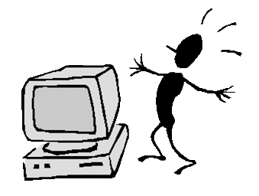
Parts of an Information System
An information system has four main components:
Data / Information
People
Owners
Users
Designers
Technology
Makes an IS faster, more efficient, more reliable
Processes
Actions that transform data into information

Slide 9
Who designs Information Systems?
Information systems are designed and created by people – known as “systems analysts”.
Their job is to study a business’s information requirements, then design and implement a system that will meet these requirements.
It is the systems analyst who is responsible for designing:
data / information
processes that manipulate the data to produce the information, and how the data / information travels from one process to another.

Slide 10


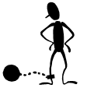



Skills of a Systems Analyst
Systems analysts are among the most sought after professionals in business and I.T.
To be a systems analyst, you must have skills in the following areas:
Analytical skills
Business skills
Ethical skills
Interpersonal skills
Managerial skills
Technical skills

Slide 11
Designing an Information System
When designing an information system, the systems analysts must consider four main areas:
External entities – people, companies or other systems that are outside of the boundary of the current system.
Data stores – files (electronic or not) that store data.
Processes – a set of actions that manipulate data.
Data flows – paths that individual data items can take (between entities, data stores and processes).
Designing the processing part of any information system is a difficult job … to make things easier, systems analysts often use a data flow diagram (DFD) to represent the inputs, processing and outputs.

Slide 12
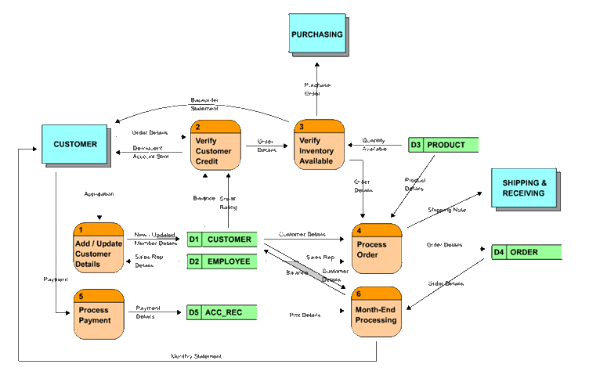
Example – DFD for an Order Processing System
CIS 2303 – Systems Analysis & Design (Sem 4)
CIB 3103 – Object Oriented Analysis & Design (App Dev / Bus Solns)

